Slide 1
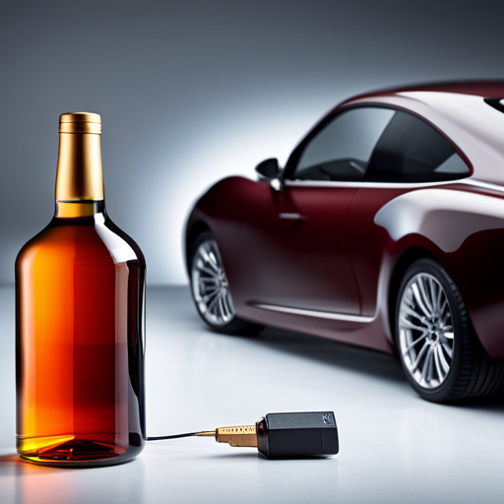
ALCOHOL DETECTION AND VEHICLE LOCKING SYSTEM

Slide 2
Introduction
Understanding the problems
Methodology
Proposed Model
Components
Working Model
Results

Slide 3
INTRODUCTION
In today's world, drunk driving has emerged as a significant cause of road accidents. Drivers under the influence of alcohol often find themselves in an unstable condition, leading to reckless driving on highways.
This paper presents a novel approach to enhance alcohol detection in an automobile ignition locking system using Arduino.
The developed analysis serves as an integral part of an automobile ignition locking system that prevents the car from starting when the driver is intoxicated.
By implementing this advanced alcohol detection system, the aim is to significantly reduce the occurrence of alcohol-related accidents and promote safer driving practices

Slide 4
Understanding the problems
01
The problem of dangerous driving extends beyond borders, demanding effective measures to address it. In India, laws prohibiting drinking and driving are in place, with the hope that hefty fines will discourage individuals from engaging in this behaviour
02
The Indian Ministry of Statistics reported thousands of road accidents in 2016. While the report identifies speeding violations as the primary cause, it can be inferred that a significant portion of these cases can be attributed to drivers being in an impaired state due to alcohol consumption.
03
By addressing the critical issue of alcohol detection in vehicles, we aim to contribute to the improvement of road safety and mitigate the devastating consequences associated with drunk driving.

Slide 5
METHODOLOGY
The Alcohol Detection with Engine Locking system is designed to reduce accidents caused by drunk driving.
It utilizes an MQ-3 sensor to detect alcohol in the environment, with its output signal based on alcohol concentration. When the concentration surpasses a threshold, the Arduino microcontroller is activated.
The microcontroller then stops the vehicle's DC motor, preventing movement, and activates a blinking red LED as a drunk driving alert. Additionally, the system creates a client and utilizes Twilio's API to send an SMS to a pre-set emergency contact number, including the vehicle's location information.
This integrated system aims to provide a comprehensive solution by combining the alcohol sensing capability of the MQ-3 sensor, decision-making of the Arduino microcontroller, LED alert system, and SMS notifications.

Slide 6
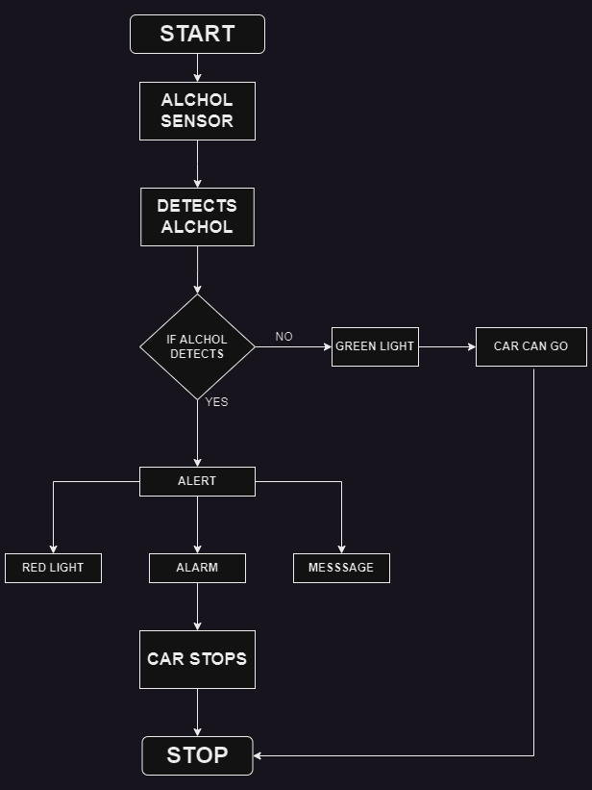
FLOW CHART

Slide 7
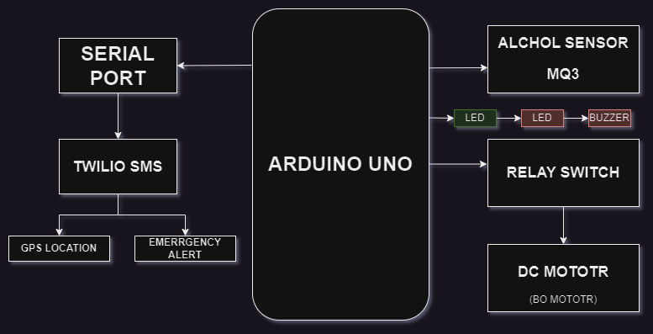
PROPOSED MODEL

Slide 8
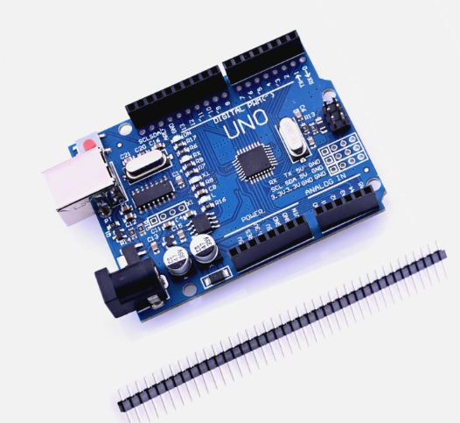
COMPONENTS
Arduino Uno:
The Arduino Uno microcontroller is chosen for its versatility, ease of use, and availability of numerous input/output pins. It provides a user-friendly programming environment, making it suitable for controlling the alcohol detection system. With its robust hardware and software ecosystem, Arduino Uno offers a reliable platform for data acquisition and system control.

Slide 9
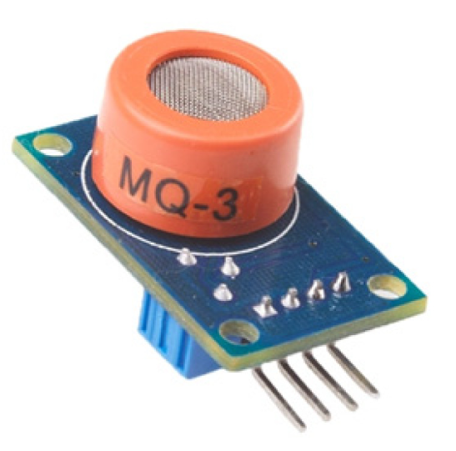
MQ-3 Alcohol Sensor:
The MQ-3 alcohol sensor is specifically designed to detect the presence of alcohol vapour. It has high sensitivity and selectivity towards ethanol, the main component found in alcoholic beverages. The MQ-3 sensor provides an analog output that can be easily interfaced with the Arduino Uno, enabling accurate detection of alcohol concentration in the surrounding air.

Slide 10
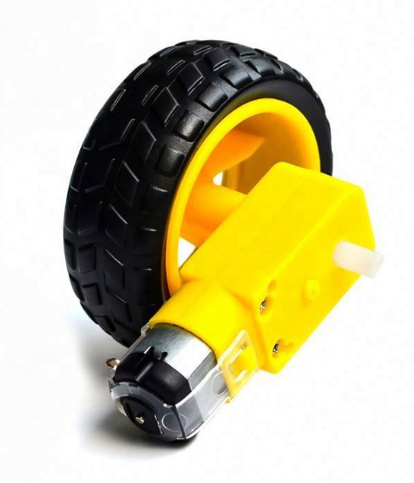
DC Motor
The DC motor serves as a practical representation of a vehicle's engine. By using a DC motor in the system, the concept of engine locking can be effectively demonstrated. When the alcohol concentration exceeds the threshold, the DC motor is stopped, symbolizing the prevention of a drunk driver from starting the vehicle. This visual representation enhances user understanding of the system's functionality.

Slide 11
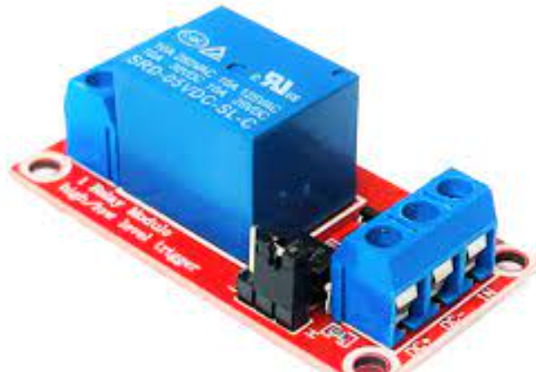
Relay
A relay is utilized to control the power supply to the DC motor. Relays offer electrical isolation between the low-voltage Arduino circuitry and the high-current DC motor. This isolation ensures the safety and protection of the components. By using a relay, the Arduino can effectively switch the power supply to the motor, allowing for precise control over the engine locking mechanism.

Slide 12
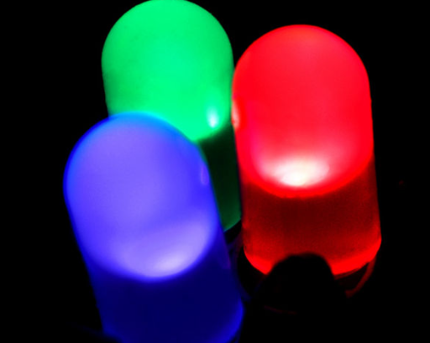
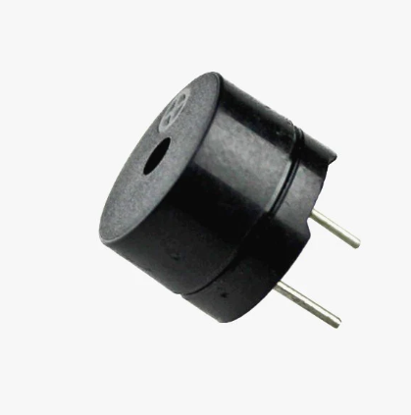
LED AND BUZZER
The LED serves as a visual indicator to convey information to the user and observers. When the alcohol concentration surpasses the threshold, the LED lights up, providing a clear visual warning. LEDs are chosen for their low power consumption, ease of use, and ability to emit bright and easily recognizable light, making them suitable for indicating the presence of high alcohol levels.
The buzzer or piezo speaker is employed as an audible alarm to enhance the warning system. When the alcohol concentration exceeds the specified threshold, the buzzer emits an alarm sound, drawing attention to the potential dangers of drunk driving. Buzzer modules are selected for their simplicity, compact size, and capability to produce loud and distinctive sounds, effectively capturing the attention of users and those nearby.

Slide 13
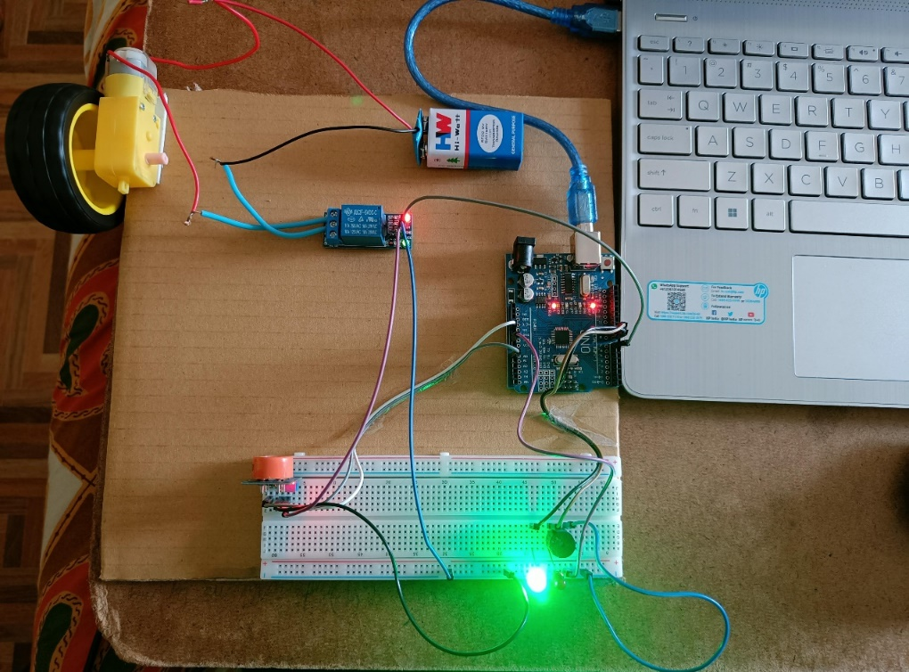
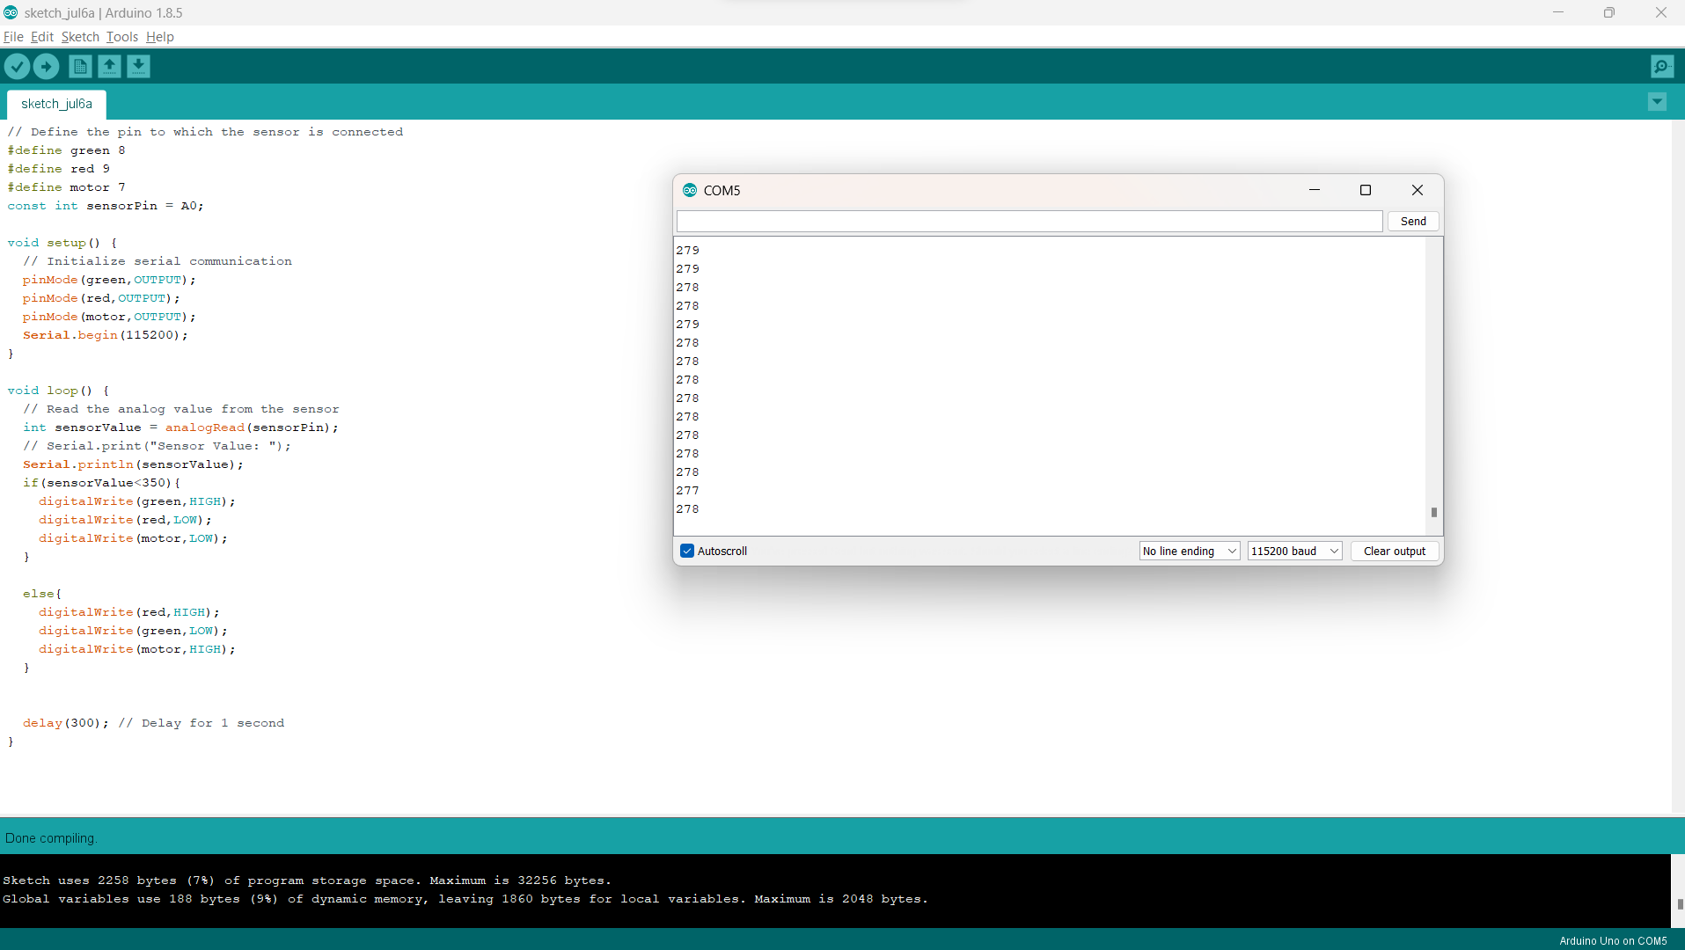
WORKING MODEL

Slide 14
RESULTS
.Arduino Uno:
The Arduino Uno microcontroller processes the data received from the alcohol sensor and performs the necessary computations.
The result from the Arduino Uno is the decision to initiate specific actions based on the alcohol concentration detected.
It can determine whether the alcohol level exceeds the predetermined threshold and subsequently activate the engine locking mechanism or trigger visual and audible warnings.
MQ-3 Alcohol Sensor:
The MQ-3 alcohol sensor is designed to detect alcohol vapor in the surrounding environment.
The result from this component is the concentration of alcohol detected, typically provided as an analog output.
The sensor's response will vary based on the alcohol concentration, allowing the system to determine the level of intoxication.

Slide 15
RESULTS
LED:
The result from the LED is a visual indication of the alcohol level exceeding the threshold.
When triggered by the Arduino, the LED lights up, providing a clear and visible warning signal.
Buzzer:
The result from the buzzer or piezo speaker is an audible alarm.
When the alcohol concentration surpasses the threshold, the Arduino activates the buzzer, generating an alarm sound.
. DC Motor:
The DC motor's result is the physical representation of engine locking.
When the alcohol concentration surpasses the specified threshold, the DC motor will stop, symbolising the prevention of a drunk driver from starting the vehicle.
The result is a clear indication that the engine is locked, reinforcing the message of responsible behaviour and discouraging further attempts to operate the vehicle.

Slide 16
CONCLUSION
The proposed alcohol detection system with its various components presents a comprehensive solution to address the critical issue of drunk driving and enhance road safety. By utilising the MQ-3 alcohol sensor, Arduino Uno microcontroller, DC motor, relay, LED, and buzzer, the system effectively detects alcohol levels, simulates engine locking, and provides visual and audible warnings.
The integration of an emergency SMS notification feature adds an extra layer of safety. In the event that the alcohol concentration surpasses the threshold, the system generates an SMS using the Twilio API. This SMS is sent to a pre-selected emergency contact, providing vital information about the vehicle's location. This feature ensures prompt intervention and assistance in case of emergencies, enhancing overall public safety.
The implementation of this system has the potential to make a significant impact by actively detecting and preventing drunk driving instances. Through continuous monitoring, engine locking, visual and audible warnings, and emergency SMS notifications, the proposed alcohol detection system provides a comprehensive solution to mitigate the risks associated with alcohol-impaired driving.

